Slide 1
Canopic Jars

Slide 2
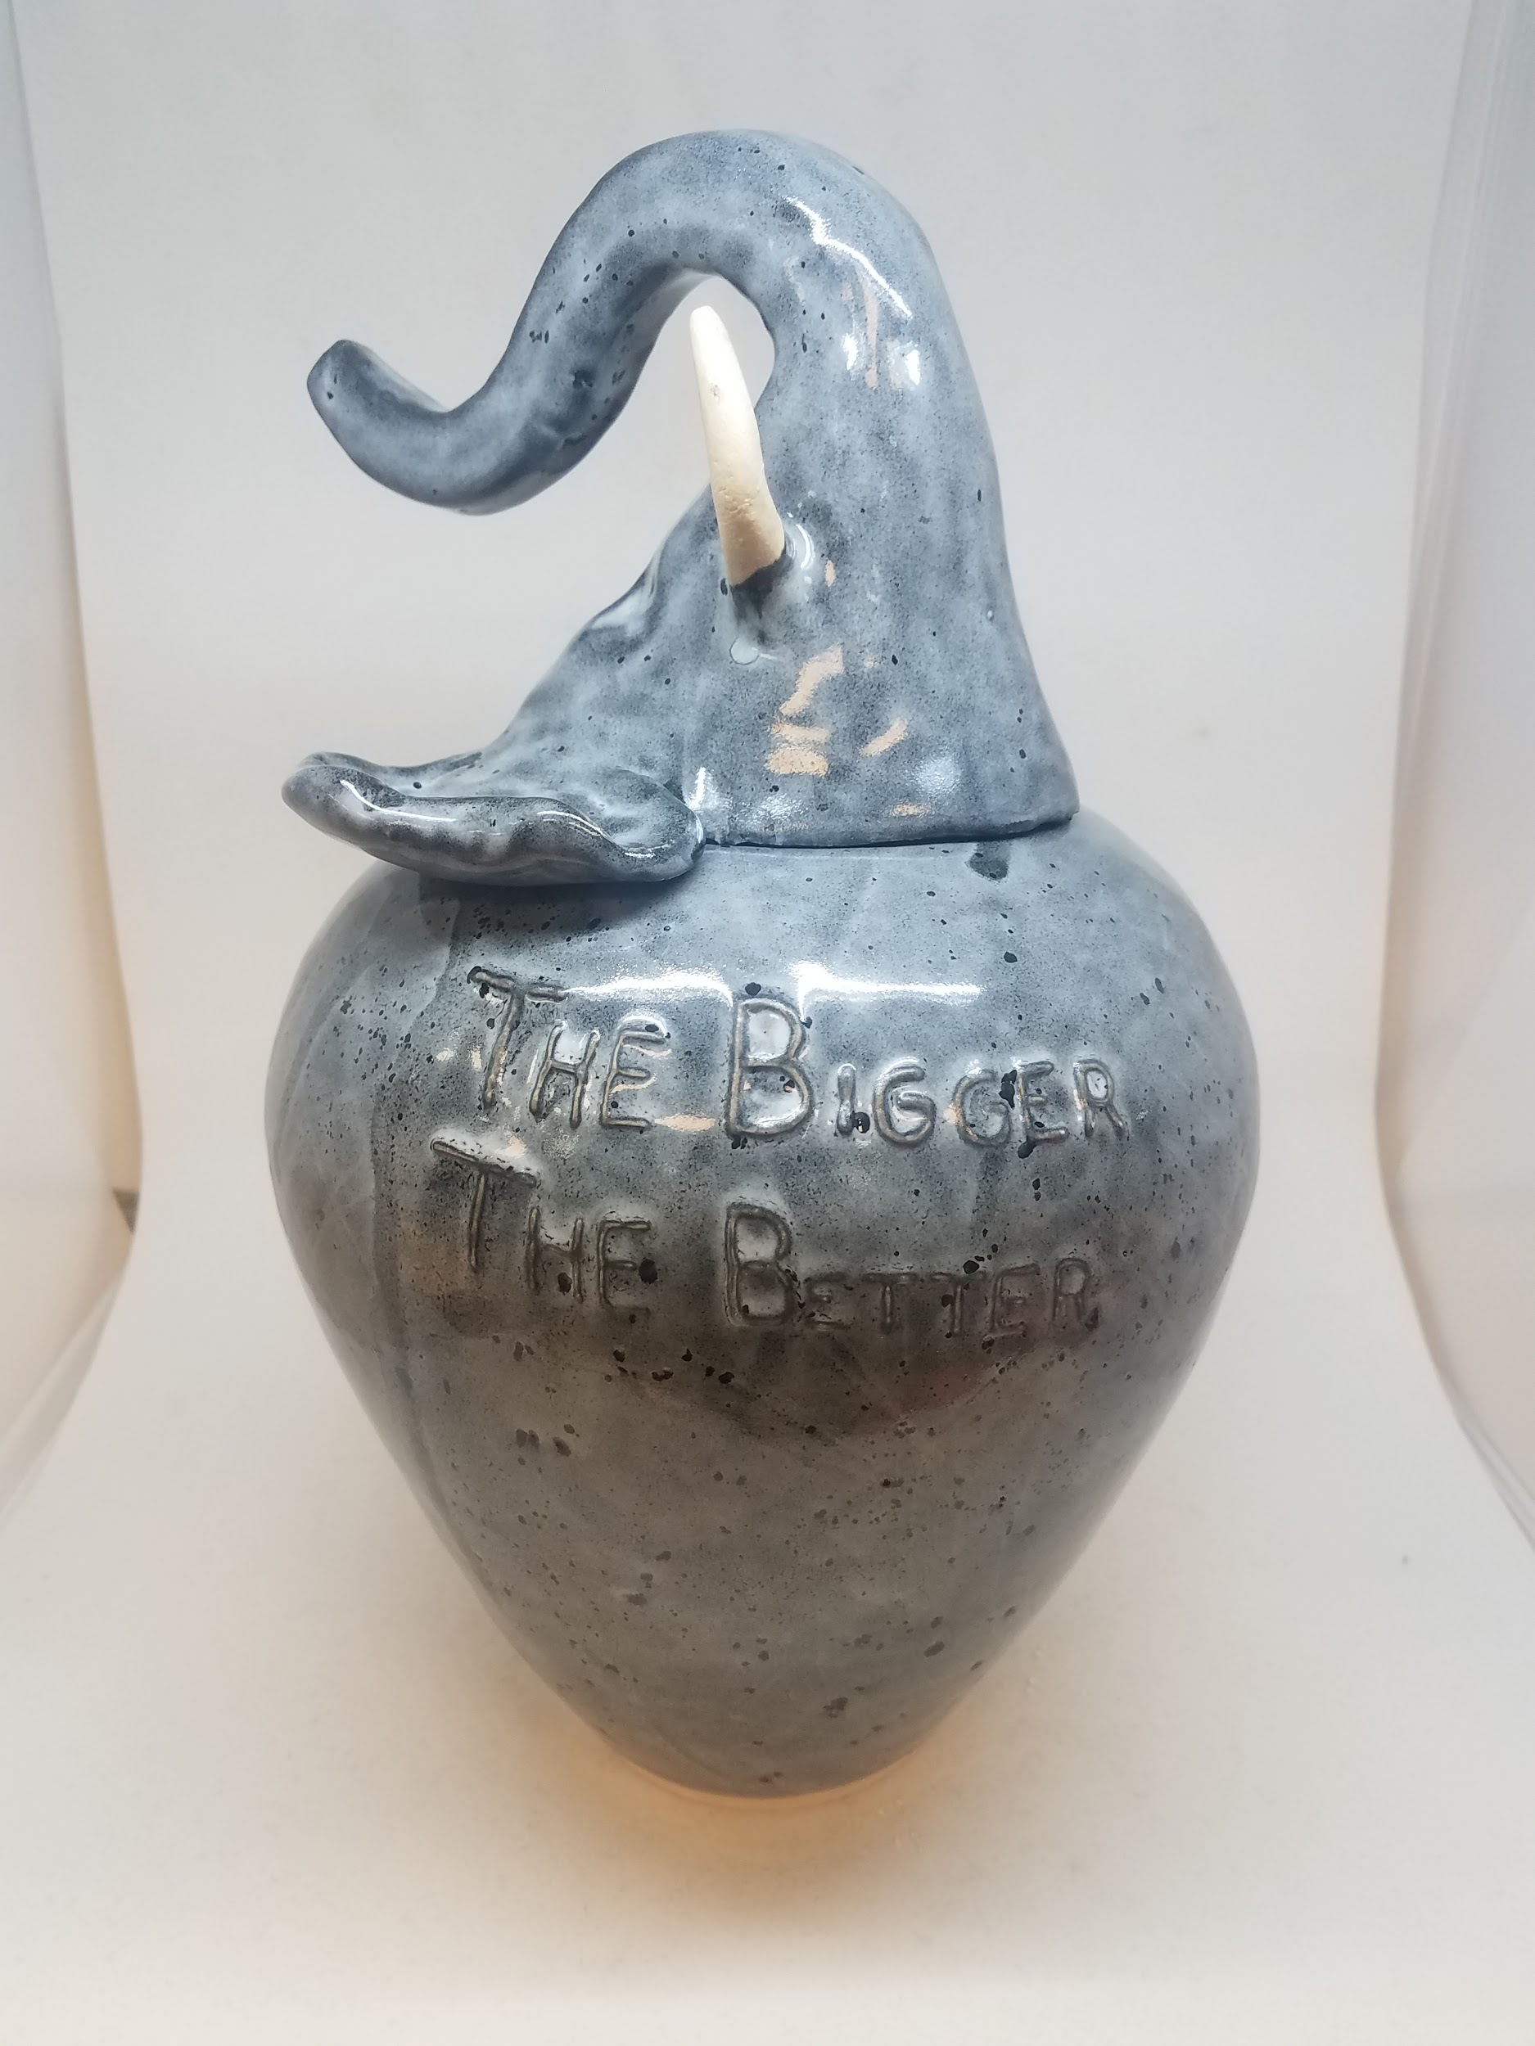

Slide 3
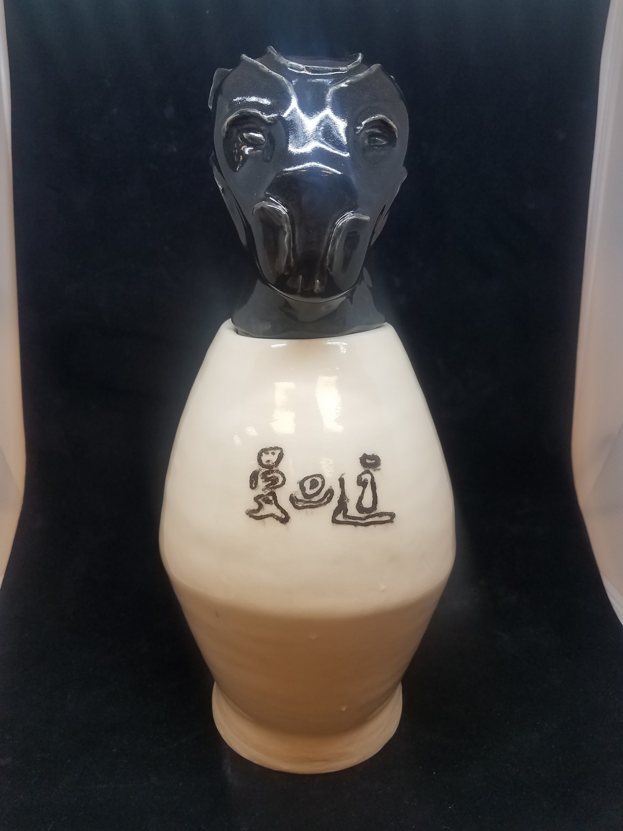

Slide 4
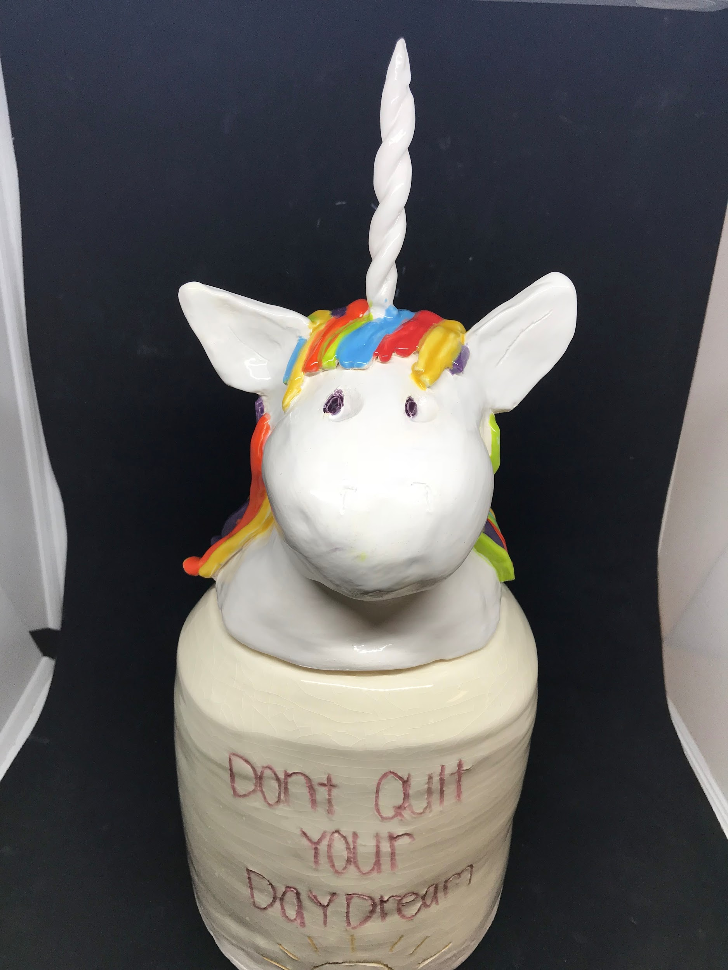
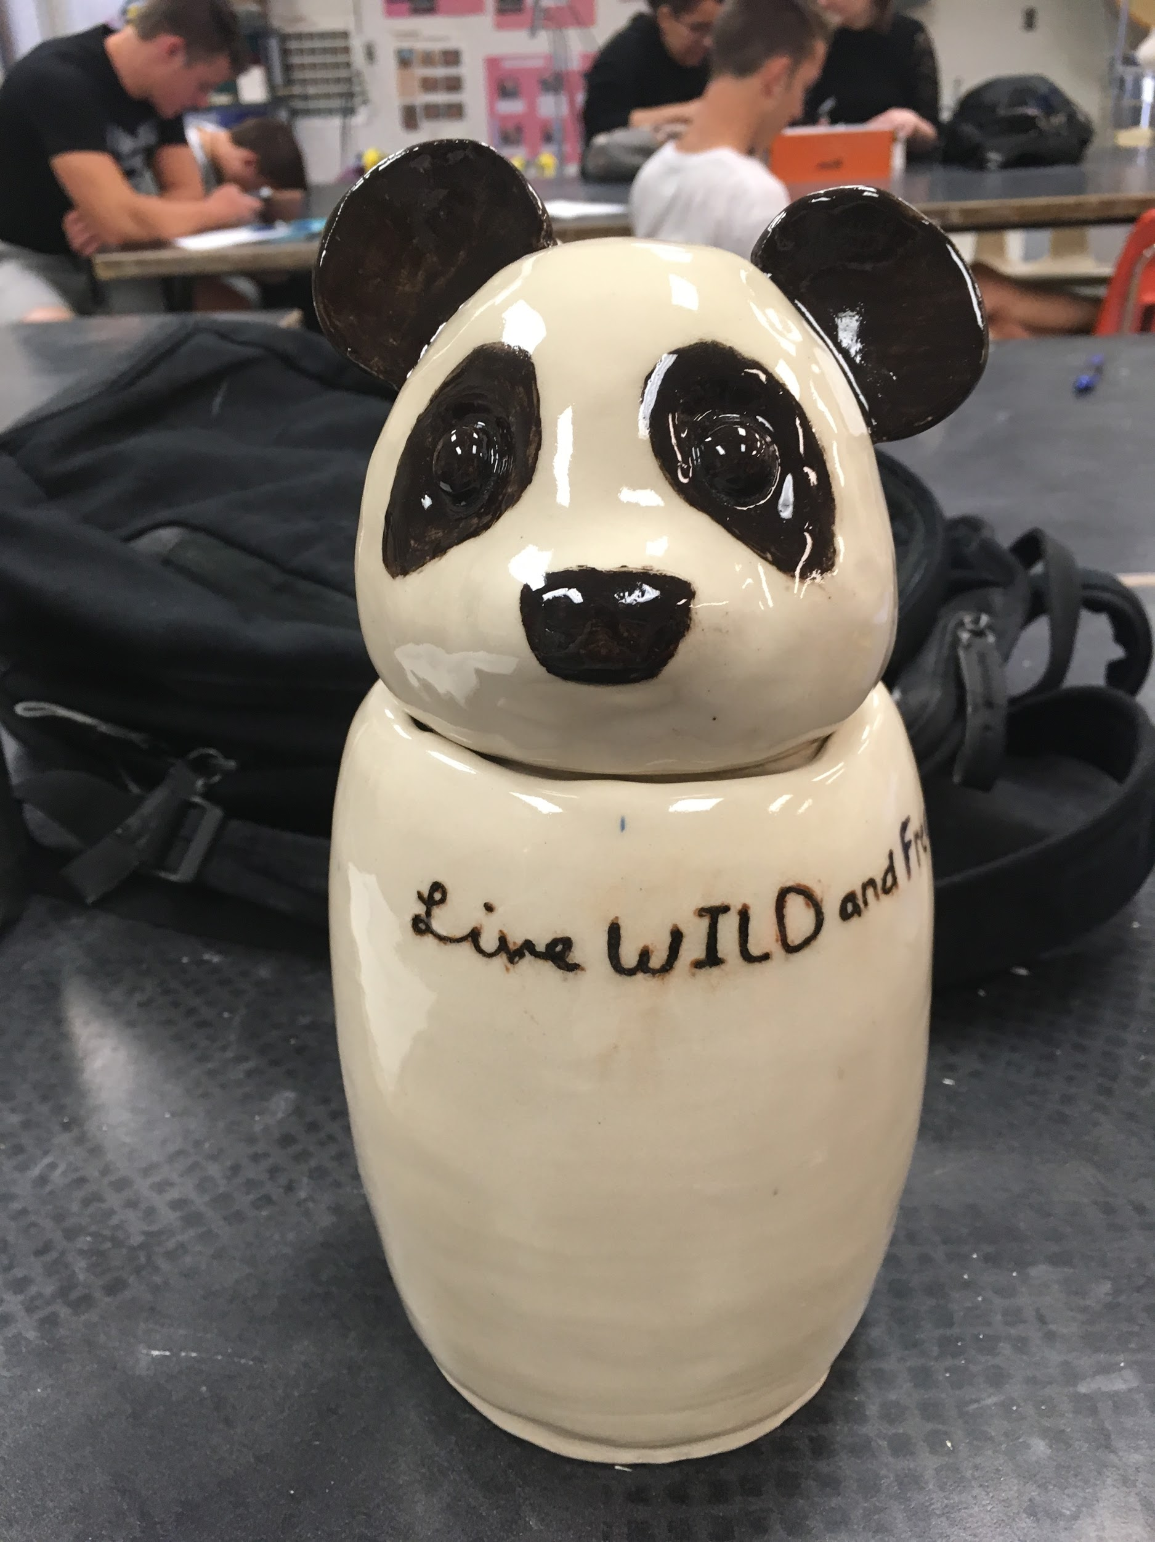

Slide 5
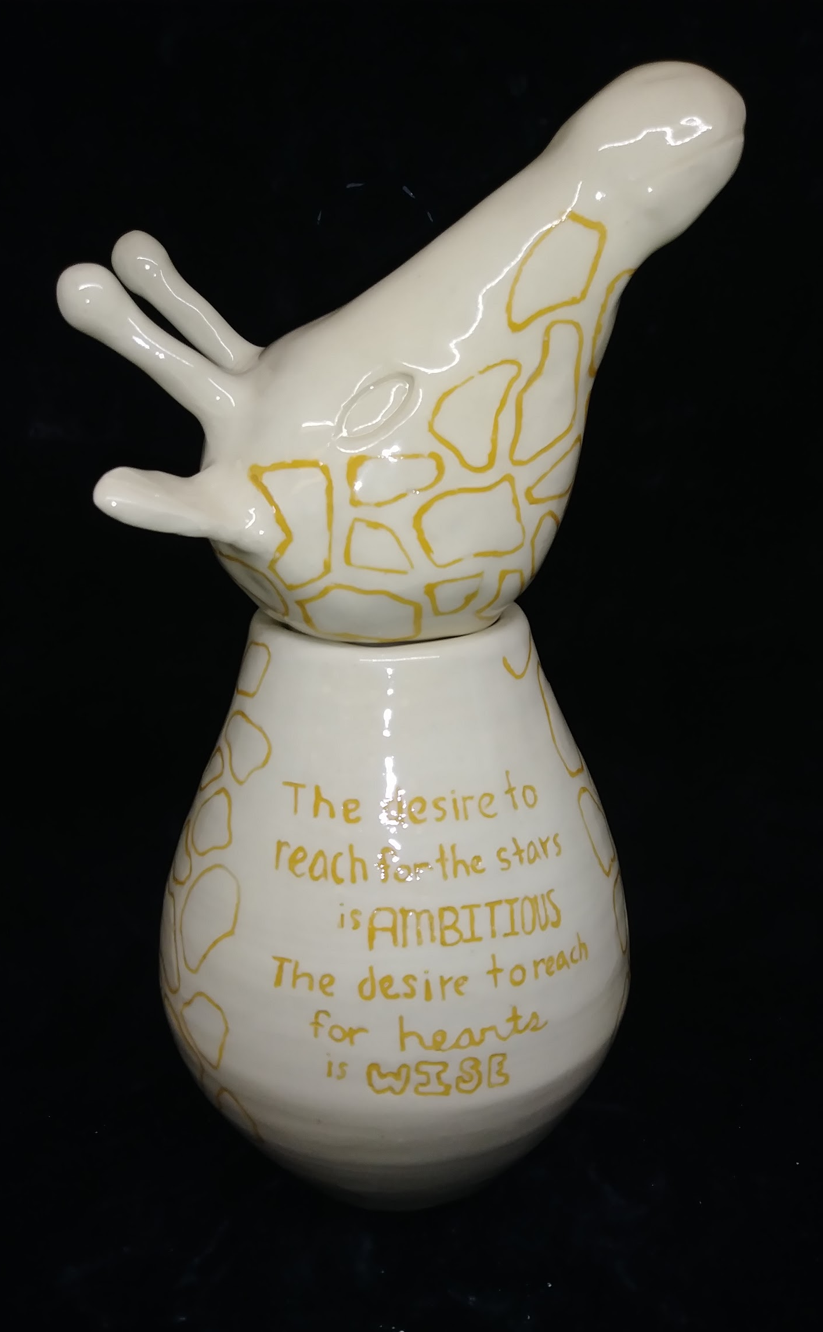
Death Jar
I have always been fascinated by the grace and elegance of giraffes. They are both beautiful and powerful. I strongly believe that there is great power in kindness, and giraffes to me are a symbol of this idea. I chose the quote from Maya Angelou, “The desire to reach for the stars is ambitious, the desire to reach for hearts is wise”. I designed the head to look as if it is reaching upwards so it would match that quote.

Slide 6
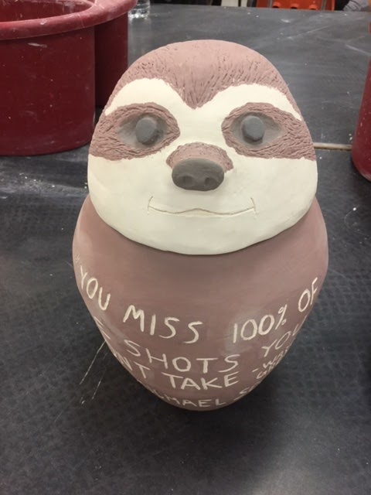
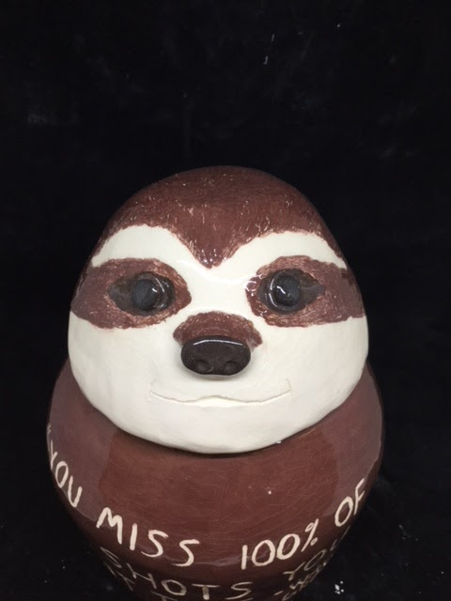
Phil
The reason I chose to create a sloth for my death jar was because they’re so cute and they’re so lazy. Whenever I have down time I just like to sit and enjoy being outside just like them. I also think there is something so majestic about them with their slow movements.
The reason that I chose the quote I did was because I am a huge fan of the office. That is always a show I can go back to and I know I’ll enjoy it.

Slide 7
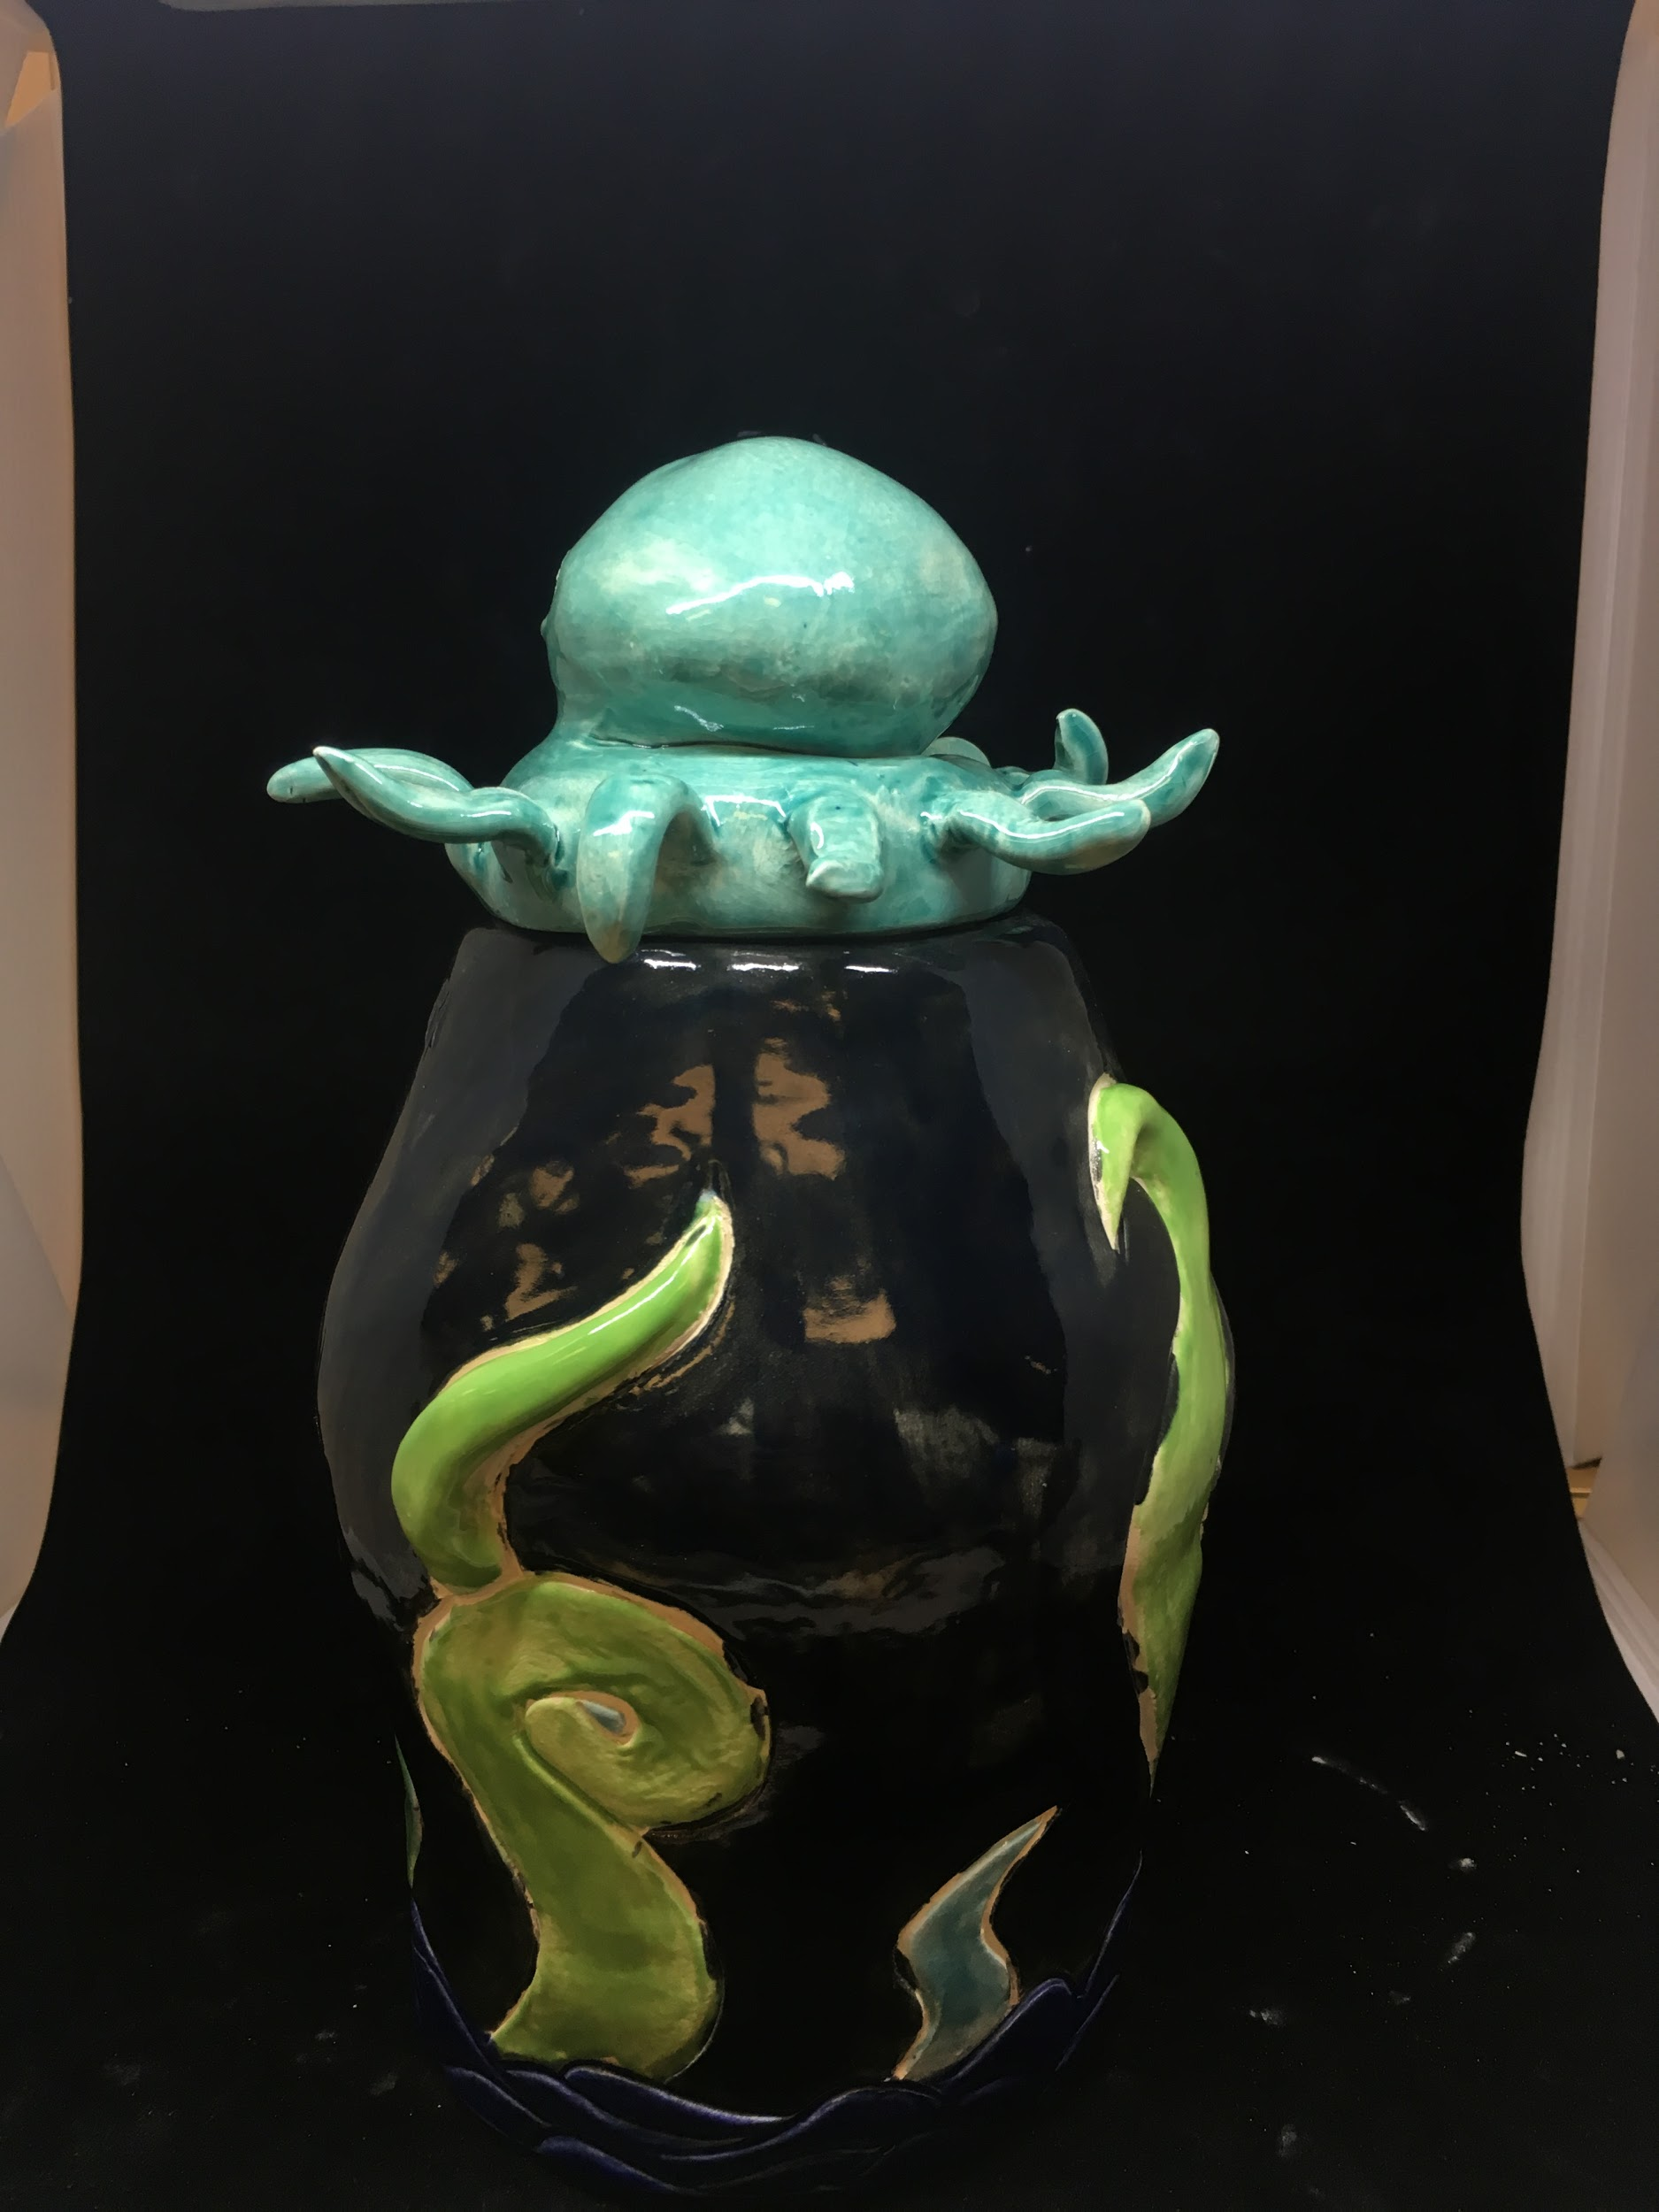
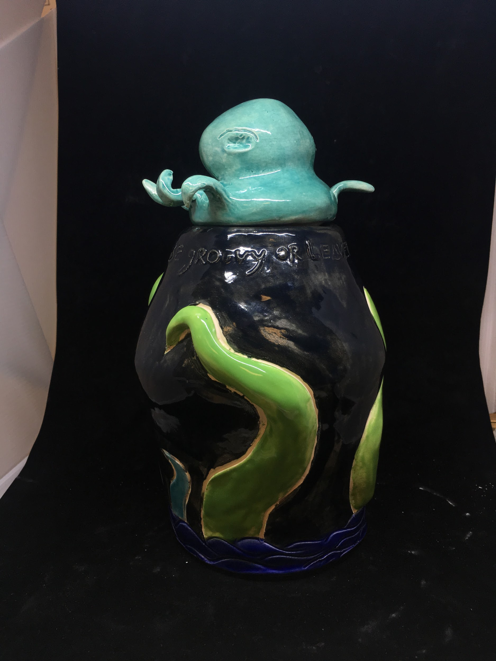
Death Jar
For my death jar I decided to go with an octopus because it is my favorite sea creature and I wanted the quote to be along the surfer, ocean vibe.

Slide 8
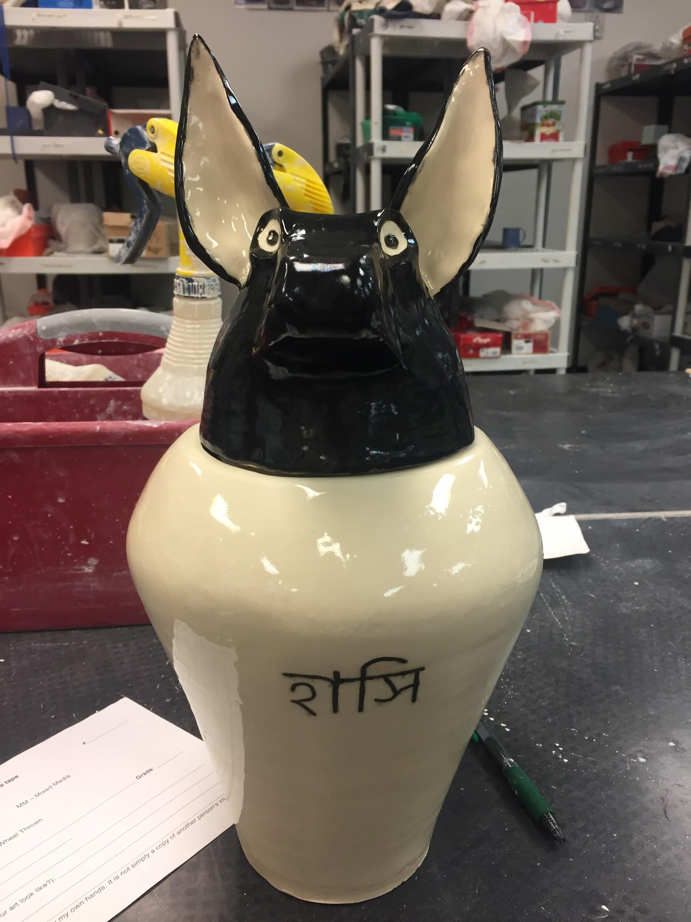
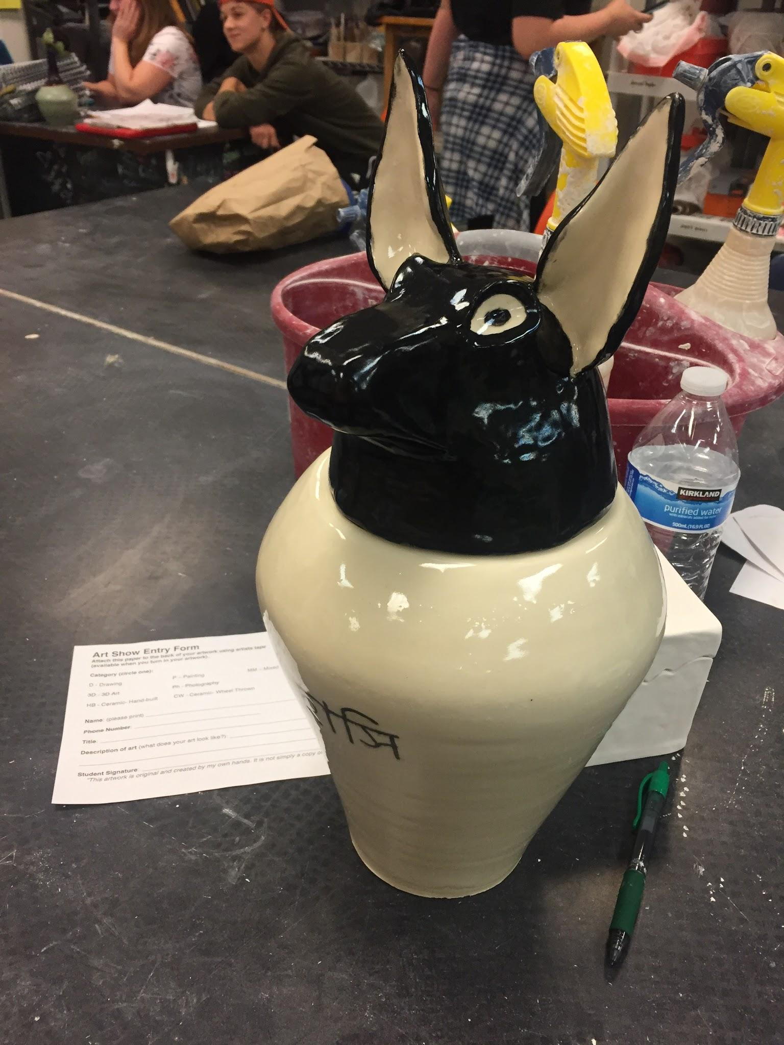

Slide 9
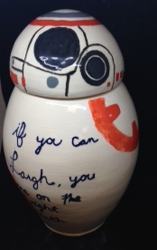
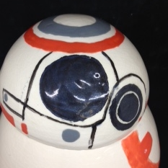

Slide 10
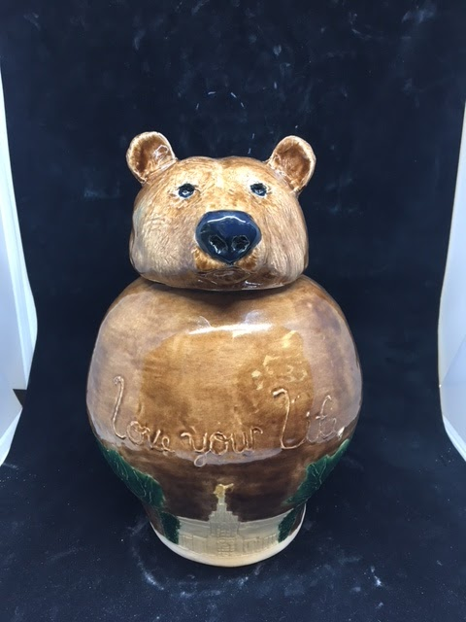
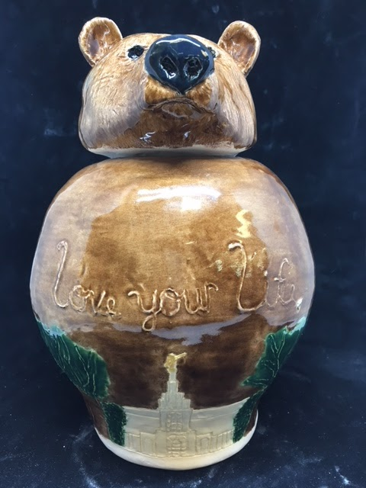
A Guideline
This project was a combination of a pinch pot and a coil jar. The Bear head is my spirit animal (according to playbuzz) and I feel that is because I will protect the ones I love when they are threatened. The words “Love your life” come from my aunt and the trials she has gone through. The temple is incised in the jar because the Temple is one of the most steadfast things in my life.

Slide 11
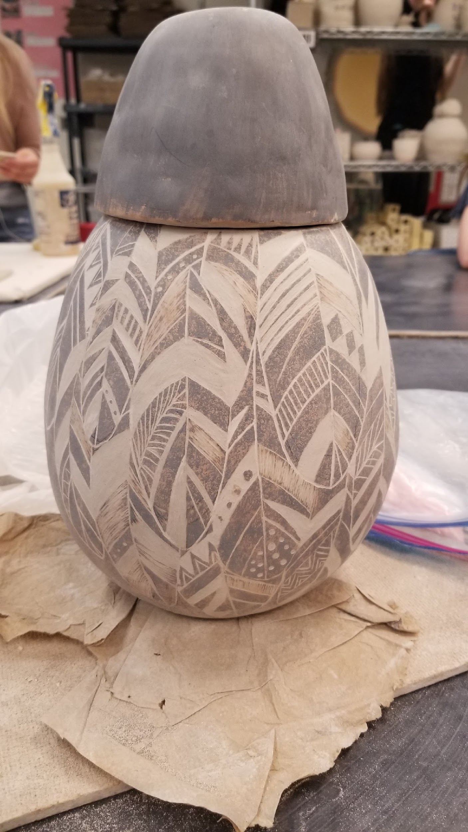
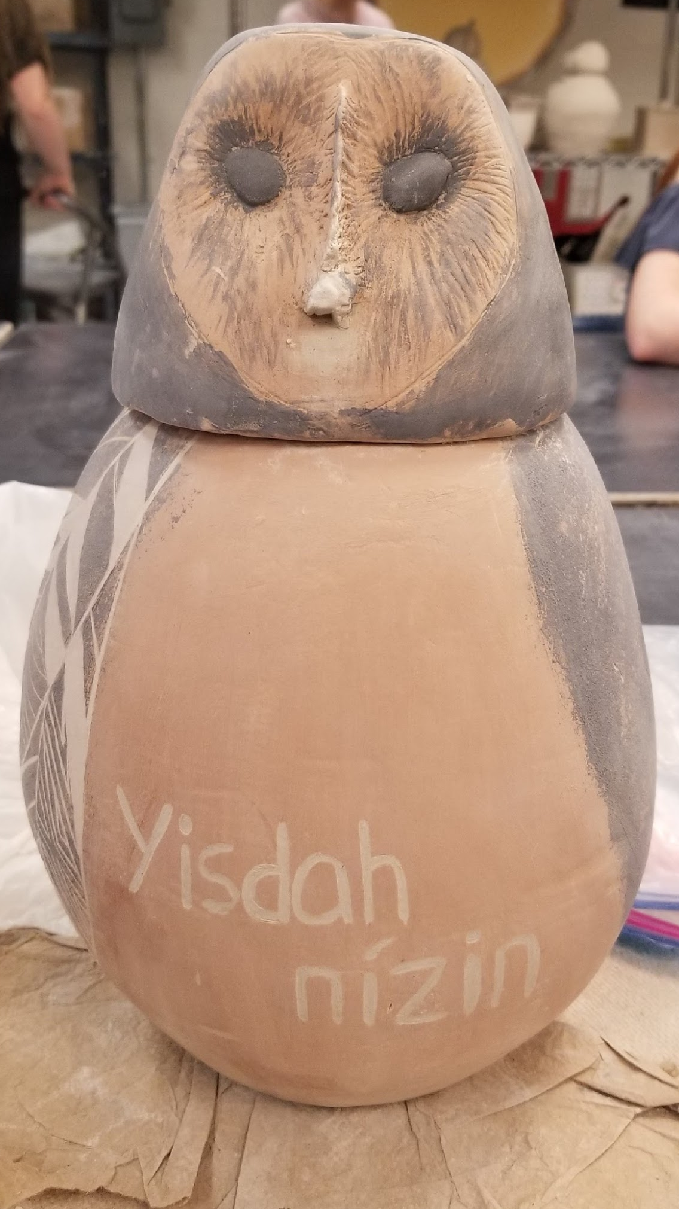
Vase -”Breathe”
For this project I chose a barn owl for my spirit animal, The words, Yisdah nízin, is breathe in navajo. I chose that word because of all the things that are jumbling in my life. I just have to take a step back and breathe for as second.
The owl is black and brown instead of its natural colors because in the navajo culture. A white owl is considered dangerous or bad omen.

