Slide 1
Ceramics 2 Decorating Techniques Quiz

Slide 2
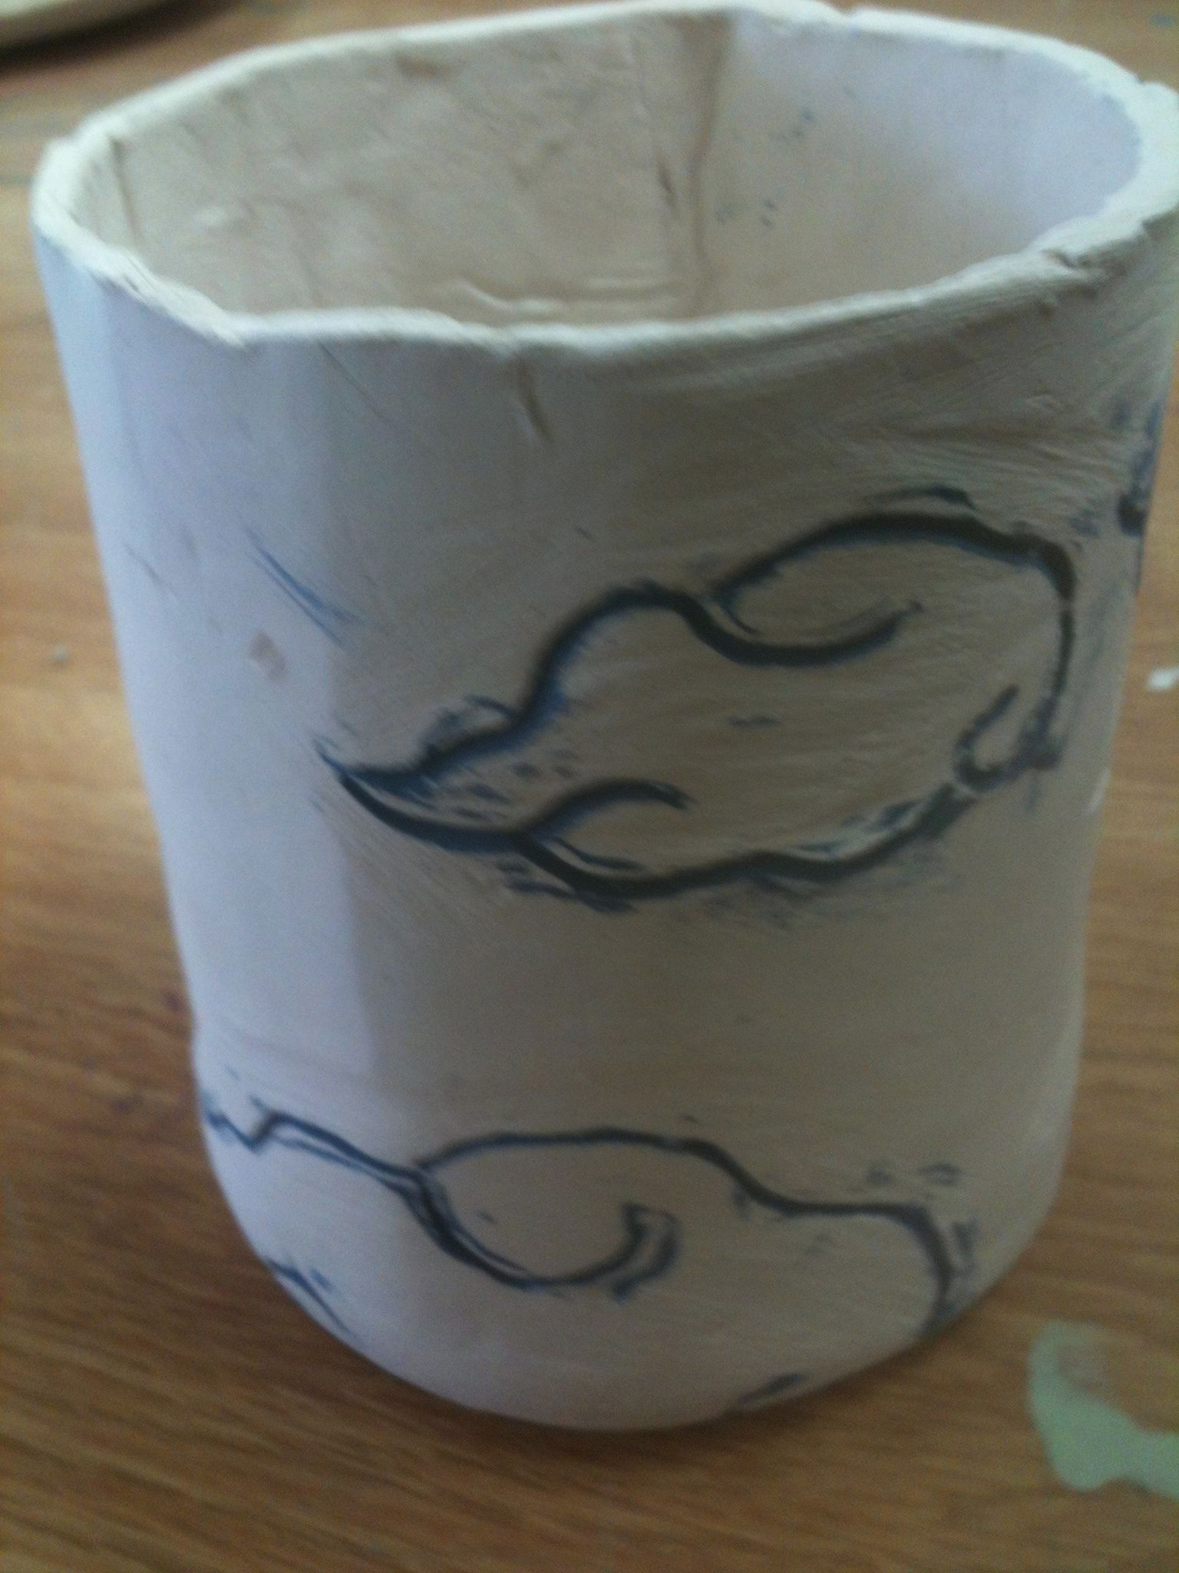
1. Which technique are these clouds?

Slide 3
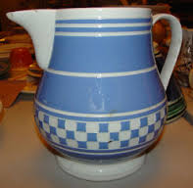
2. The stripes on this could have been done using which technique?

Slide 4
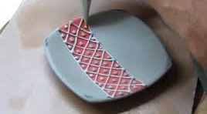
3. The pattern on this plate is using which method?

Slide 5
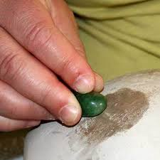
4. What is this person doing with this stone?

Slide 6
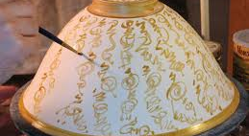
5. This person is painting on a tacky substance straight onto the clay. What is this technique called?

Slide 7
6. Do you need to glaze a piece that has been polished to a shine?
7. Why or why not?

Slide 8
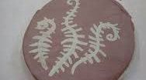
8. Which technique would do this? (white and red clay together)

Slide 9
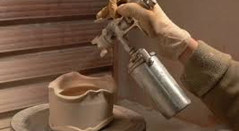
9. What is this person doing?

Slide 10
10. What is the main reason someone might want to use this technique?
11. How many layers should you add?

Slide 11
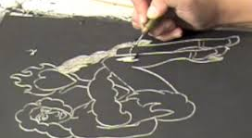
12. This person is scratching black slip off of the clay surface. What is this technique called?

Slide 12
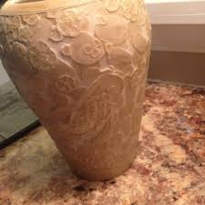
13. This raised surface design is created on greenware using a tacky surface. Which one is this?

