Slide 1
Bell Ringers
Ceramics 1

Slide 2
Directions: First 10 minutes
Pick a seat…. Do NOT move chairs, rather move yourself to an open seat. Try to pick somewhere you will be able to pay attention, but also want to stay for the term.
Introduce yourself to your neighbors….yes everyone.
Tell them one unique fact about yourself.

Slide 3
Directions:
Take 5 blank papers from pile on your table.
Take 1 cover sheet
Staple 2x on the side like a book
Fill out the cover page
Wait for further instruction

Slide 4
Bell Ringer #1 Functional Vs. Nonfunctional
What do you think it means for something to be functional or nonfunctional?
Defend your answer in complete sentences!

Slide 5
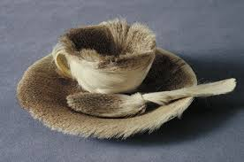
Bell Ringer #1 Which would you rather drink out of? A. B.

Slide 6
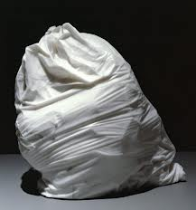
Bell Ringer #2 Sketch and write.
‘Hefty 2 Ply’ by Jud Nelson
(Answer the question)
*Do you think this is art? Why or why not?

Slide 7
Bell Ringer #3
Write your own definition of Art. Include what it is, where you can find it, when it happens, and who makes it. Be specific. (don’t use phrases like: anything, everywhere, all the time, anyone).
Be ready to share

Slide 8
Bell Ringer #4
List all 8 Tools and their purpose:

Slide 9
Bell Ringer #5
What are the 3 types of wedging?
Which type of wedging is best for mixing really wet clay and really dry clay?

Slide 10
Bell Ringer #6
Maria Martinez: Pueblo Native American Indian from San Idlefonso. New Mexico.
Her son Popovi De and her created the black on black matte pottery
Famous for coil building all of her pots and firing her own pottery in ‘pit’ fires.
Born 1887 Died 1980

Slide 11
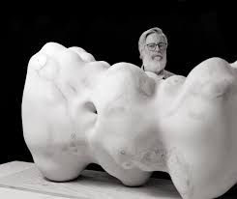
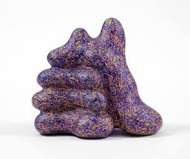
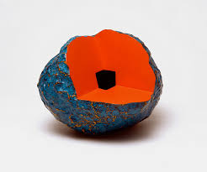
Bell Ringer #7
Ken Price: 1935 -2012 Contemporary artist
Built with coils to sculpt very large abstract shapes. Also was a printmaker and often his prints coincided with his sculpture.

Slide 12
Bell Ringer #8 What is an Art Critique
Describes: describe the artwork as if you are explaining in detail to someone who cannot see the work.
Analyzes: Using the elements and principles of art, you analyze the structure of the piece.
Interpret: Answers the question ‘What is going on in the artwork?’
Decides: Do you like this piece, why or why not?

Slide 13
Bell Ringer #9 Leave space between for drawing and writing
Elements and Principles of Art
Elements: Principles:
Line Focal Point
Shape Balance
Value Movement
Color Repetition/Variation
Texture Unity/Harmony
Form Pattern
Space

Slide 14
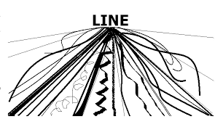
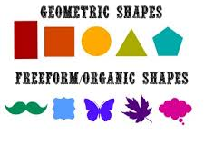
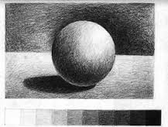
Bell Ringer #10 Write and draw the examples:
Line: Includes organic and geometric lines.
Shape: Includes organic and geometric shapes. Also referred to as regular and irregular shapes.
Value: Includes all values between black and white as well as black and white. Most value scales have about 10 gradients of the gray scale.

Slide 15
Bell Ringer #11
Color: All colors except black and white. Usually references color schemes such as monochromatic, analogous, complementary, Secondary, Primary, etc.
Texture: Refers to how something either feels, or looks like it feels.
Form: Refers to the 3-Dimensional appearance of an object
Space: Refers to positive/negative space within an artwork. Positive being the subject or foreground of a work of art, the Negative being the background or unimportant pieces of a work.

Slide 16
Bell Ringer #12 The FOCAL POINT/AREA OF EMPHASIS
Created by the area of greatest contrast
Contrast means differences…..
When applying the elements: a contrast of two elements creates the focal point.
EXAMPLES:
Value= black and white
Color = complementary colors (red/green, blue/orange)
Texture = smooth, rough or prickly
Line = thick or thin, straight or jagged
Shape= circle and irregular shape

Slide 17
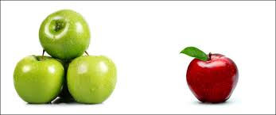
Bell Ringer #13
Balance: The equal distribution of visual weight. Occurs around a vertical axis; our eyes require the visual weight to be equal on the two sides of the axis.
2 Kinds:
Symmetrical/Formal Balance: Achieves balance by repetition. Mirror image on both sides of the axis line.
Asymmetrical/Informal Balance: Achieves balance through contrast. Involves different elements that have equal visual weight; the weight is equal but the elements are not.

Slide 18
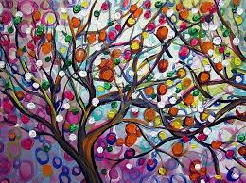
Bell Ringer #14
Unity is the relationship among the elements of a visual that helps all the elements function together. Unity gives a sense of oneness to a visual image. It helps organize a visual image, facilitating interpretation and understanding.
Question: Which
element is unifying this
Piece?

Slide 19
Bell Ringer #15
Movement: Principle of Design/Art. It is the path the viewer’s eye takes through the artwork, often to a focal area. It can be directed along lines, edges, shapes and color. Movement is closely tied to rhythm.

Slide 20
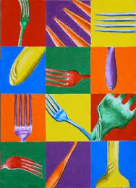
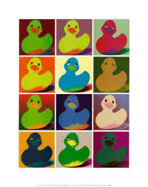
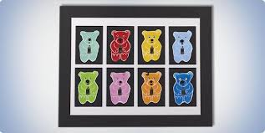
Bell Ringer #16 Repetition and Variation
Principle of art
Repetition is the repeating of an element, and variation is changing the repeated item in some way to make it more visually interesting.

Slide 21
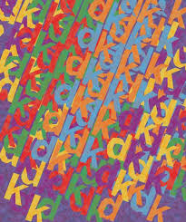
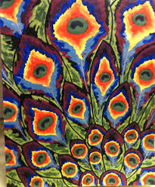
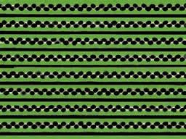
Bell Ringer #17 Pattern
Principle of Art
Pattern refers to the repetition or reoccurrence of a design element, exact or varied, which establishes a visual beat.

Slide 22
Bell Ringer #18 Write down the following questions, then wait for further instruction.
Which element/s do you see being used in this artwork?
What principles are being used?
How does this painting make you feel?

Slide 23
Please take 30 seconds to study this artwork ‘Guernica’ by Pablo Picasso and then answer the questions from the previous slide.

Slide 24
Bell Ringer #19 Study the picture

Slide 25
Corner Vote: What’s the focal point?
Corner 1: The man in the pothole?
Corner 2: The man falling?
Corner 3: The man that’s falling….. His face?
Corner 4: The foot that’s in the air?

Slide 26
Bell Ringer #20 Sketch the sculpture

Slide 27
Answer
What’s the focal point?
Face
Shoe
Hands
Table
2. Which element is creating the focal Point?
Color
Space
Value
Texture

Slide 28
Bell Ringer #21 1. Sketch the following artwork: ‘Spoonbridge and Cherry’ by Claes Oldenburg, and Coosje Van Bruggen

Slide 29
Which principle would you use to describe this piece?
Movement
Unity
Pattern
Emphasis

Slide 30
Bell Ringer #22
Low Fire Glaze:
Doesn’t run, paint all the way to bottom
Paint 3-5 coats
Paint in opposite directions on each new layer
Once you start a layer – don’t stop until the entire layer is done
Glaze is like watercolor in that the dark will show under a lighter color, so paint in each area like a paint by number
The clear glaze runs – so don’t put more than 2 layers
High fire and low fire glaze CANNOT be mixed together

Slide 31
Bell Ringer #23 1. Describe this work of art:

Slide 32
2. Analyze this work of art: (practice using the elements and principles)

Slide 33
3. Interpret: (What is going on?)

Slide 34
4. Decide: Do you like this? Why or why not?

Slide 35
Bell Ringer #24 Critique this installation: (all 4 steps that we practiced last class)

Slide 36
Bell Ringer #25
Scott Adams definition of art (cartoonist for Dilbert) “Creativity is allowing yourself to make mistakes. Art is knowing which ones to keep.”
Describe when you have experienced something similar…

Slide 37
Bell Ringer #26

