Slide 1
Decoration Techniques Quiz
Ceramics 1

Slide 2
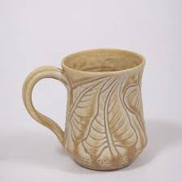
#1 – the leaves are?

Slide 3
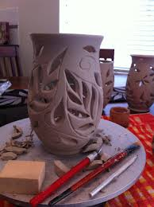
#2

Slide 4
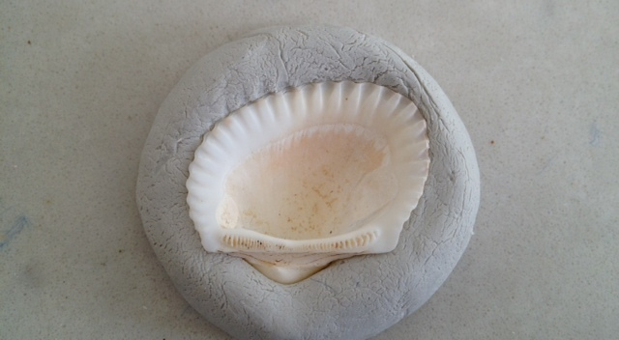
#3

Slide 5
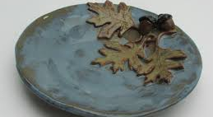
#4 – the leaves on this

Slide 6
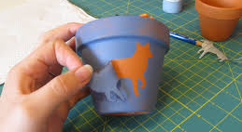
#5 – What is this wolf decoration called?

Slide 7
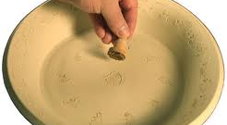
#6

Slide 8
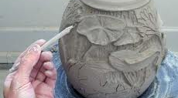
#7

