Slide 1
Stamps

Slide 2
Requirements
The first stamp will be a symbol or logo of who you are, or your signature.
Must be able to hold in hand easily without discomfort.
Will need to be done in mirror image of your actual design.
Must be at least the size of a quarter
Must be used on every project

Slide 3
Darby Huffman; Port Townsend, Washington

Slide 4
Tamela Wells

Slide 5
Carolyn and Dave Good

Slide 6
Tristan Mardell

Slide 11
Darby and Phoebe of Daily Bird Pottery

Slide 12
Rolling Stamp
Must go all the way around the coil
Must be carved fairly deep
Can use any tool to create design
Must be cleaned up well
Needs to be at least 4” long

Slide 13
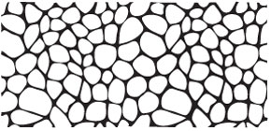

Slide 18
http://www.clay-king.com/pottery_tools/mkm_handrollers.html

